Slide 1






JAVA - MULTITHREADING

Slide 2



JAVA IS A MULTI-THREADED PROGRAMMING LANGUAGE
which means we can develop multi-threaded program using Java.
A multi-threaded program contains two or more parts that can run concurrently and each part can handle a different task at the same time making optimal use of the available resources specially when your computer has multiple CPUs.

Slide 3

JAVA MULTITHREADING

Slide 4


MULTI-THREADING
Multithreading in Java is a process of executing multiple threads simultaneously.
enables you to write in a way where multiple activities can proceed concurrently in the same program.
To achieve the multithreading (or, write multithreaded code), you need java.lang.Thread class.

Slide 5
THREAD
A thread is a lightweight sub-process, the smallest unit of processing. Multiprocessing and multithreading, both are used to achieve multitasking.
MULTITASKING
A process of executing multiple tasks simultaneously. We use multitasking to utilize the CPU. Multitasking can be achieved in two ways:
Process-based Multitasking (Multiprocessing)
Thread-based Multitasking (Multithreading)

Slide 6

Advantages of Java Multithreading
1) It doesn't block the user because threads are independent and you can perform multiple operations at the same time.
2) You can perform many operations together, so it saves time.
3) Threads are independent, so it doesn't affect other threads if an exception occurs in a single thread.

Slide 7


BENEFITS OF MULTITHREADING
Improved Performance:
Multithreading enables the execution of multiple tasks concurrently, utilizing the available CPU cores efficiently and enhancing overall performance.
Responsiveness:
Multithreading ensures that applications remain responsive to user interactions even when performing time-consuming operations
Parallelism:
Threads can be used to divide a complex task into smaller subtasks that can be executed in parallel, taking full advantage of multi-core processors.

Slide 8
BENEFITS OF MULTITHREADING
Background Processing:
Threads allow background processing of tasks, such as file I/O, network communication, or data processing, without blocking the main application flow.
Utilization of Resources:
By utilizing multiple threads, programs can make better use of system resources, leading to better resource allocation and management.

Slide 9


TYPES OF THREADS

Slide 10

1.User Threads
also known as application threads, are threads that are explicitly created by the programmer to perform specific tasks.
They play a direct role in the main functionality of the application.
User threads continue executing until their task is completed or until the application explicitly terminates them.

Slide 11
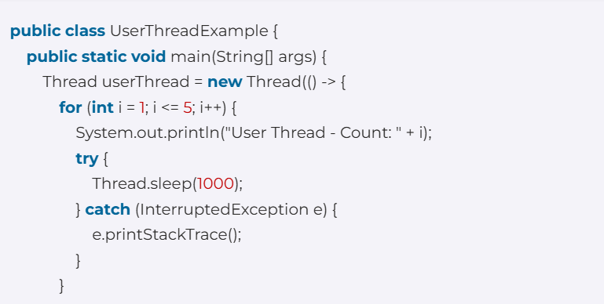

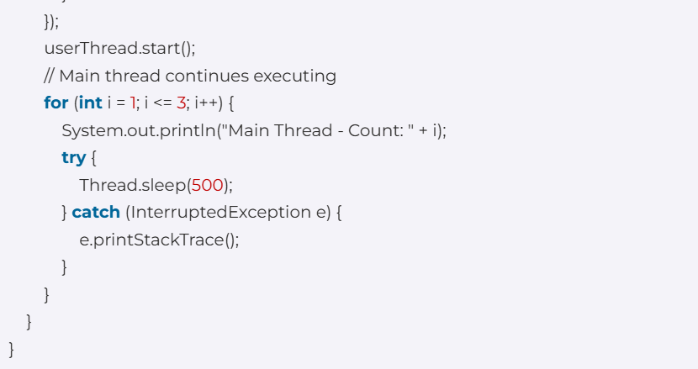
CODE

Slide 12

OUTPUT

Slide 13
Daemon Threads
threads that provide support to user threads. They run in the background and are considered "service" threads.
Unlike user threads, daemon threads do not prevent the JVM from exiting, even if they are still running. When all user threads have finished executing, the JVM terminates, abruptly stopping any remaining daemon threads.
are commonly used for tasks such as automatic memory management (garbage collection) or other housekeeping activities that should not delay the program's termination.

Slide 14
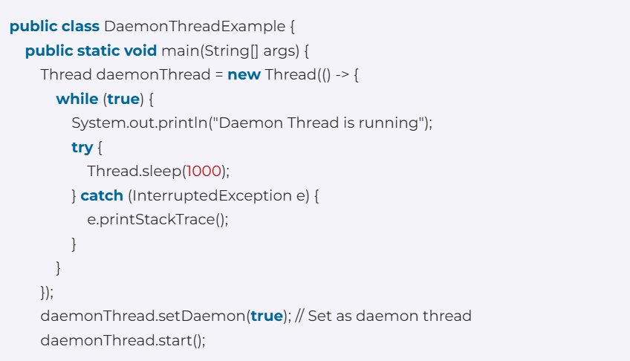
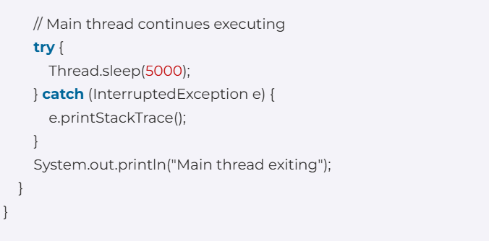
CODE

Slide 15

OUTPUT

Slide 16

How to create a thread in Java
 | By Extending Thread Class
 | By Implementing Runnable Interface

Slide 17


Thread Class
The simplest way to create a thread in Java is by extending the Thread class and overriding its run() method.
Thread class provide constructors and methods to create and perform operations on a thread. Thread class extends Object class and implements Runnable interface.

Slide 18
Constructors of Thread Class
Thread() | Thread(String name) | Thread(Runnable r)
 | Thread(Runnable r, String name)

Slide 19
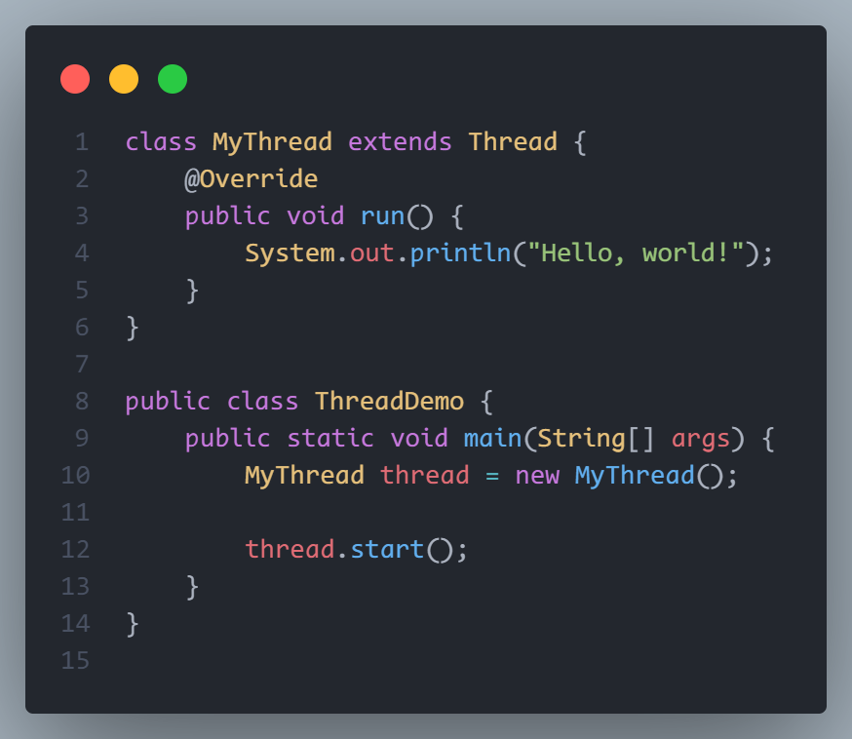
Usage

Slide 20
Java Runnable Interface
Java runnable is an interface used to execute code on a concurrent thread. It is an interface which is implemented by any class if we want that the instances of that class should be executed by a thread.
The runnable interface has an undefined method run() with void as return type, and it takes in no arguments.

Slide 21
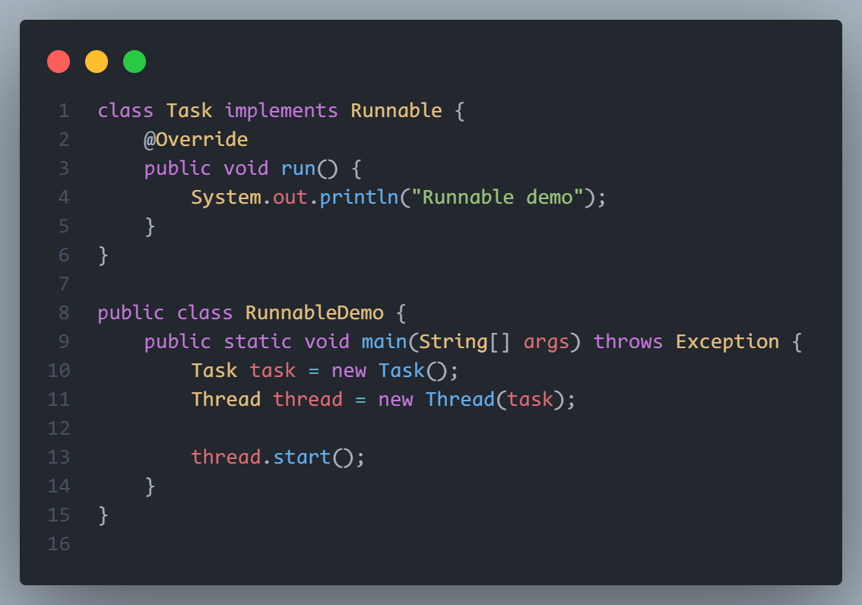
Usage

Slide 22
Synchronized keyword
In Java, using the synchronized keyword is a way to obtain a lock to a method or a code block.
Code that is under the synchronized keyword can only be executed by a single thread at a time. This can be used to prevent data corruption and improve data consistency in a multithreaded application

Slide 23
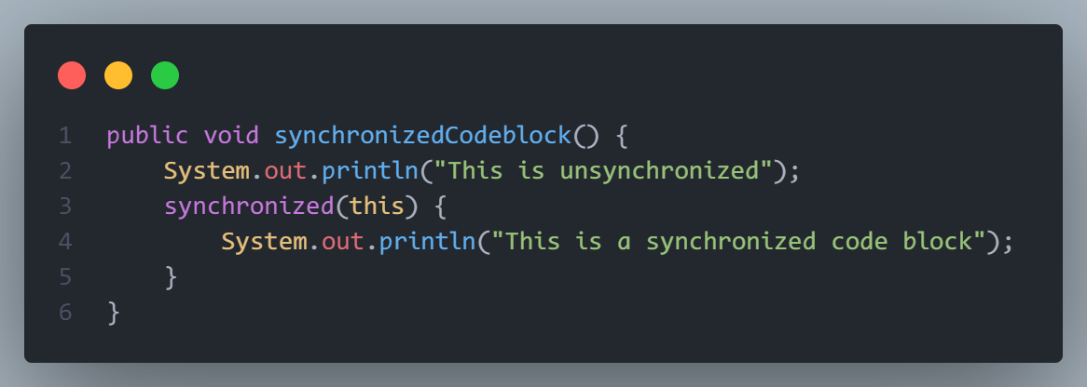
Synchronized Code Block Example

Slide 24
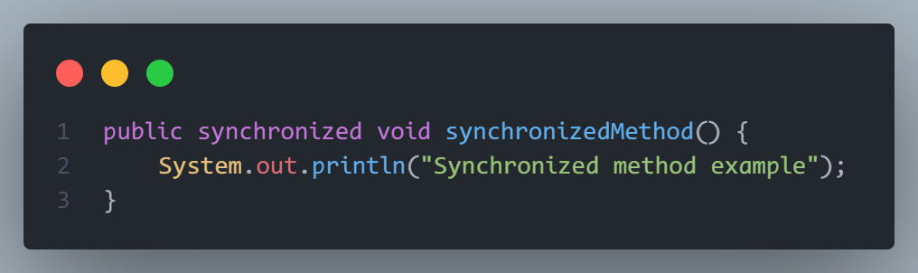
Synchronized Method Example

Slide 25
 | Deadlock
 | Race Condition
 | Thread Starvation
Multithreading
Problems

Slide 26
Deadlock
Deadlock can occur in a situation when a thread is waiting for an object lock, that is acquired by another thread and second thread is waiting for an object lock that is acquired by first thread. Since, both threads are waiting for each other to release the lock, the condition is called deadlock.

Slide 27
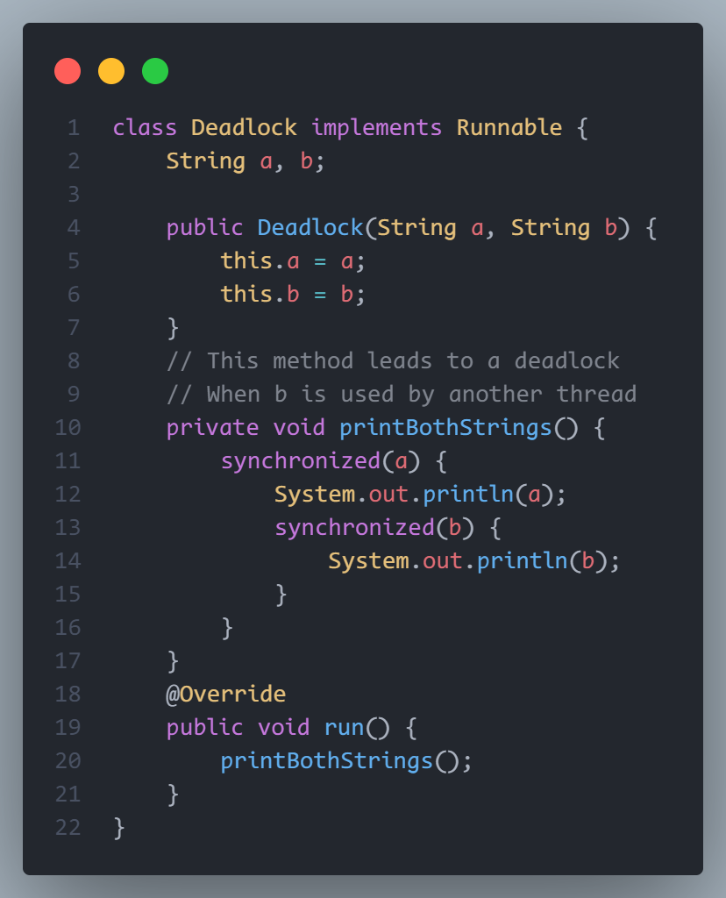
Deadlock Example

Slide 28
Race Condition
A condition in which the critical section (a part of the program where shared memory is accessed) is concurrently executed by two or more threads. It leads to incorrect behavior of a program.
in layman terms, it is a condition in which two or more threads compete together to get certain shared resources

Slide 29
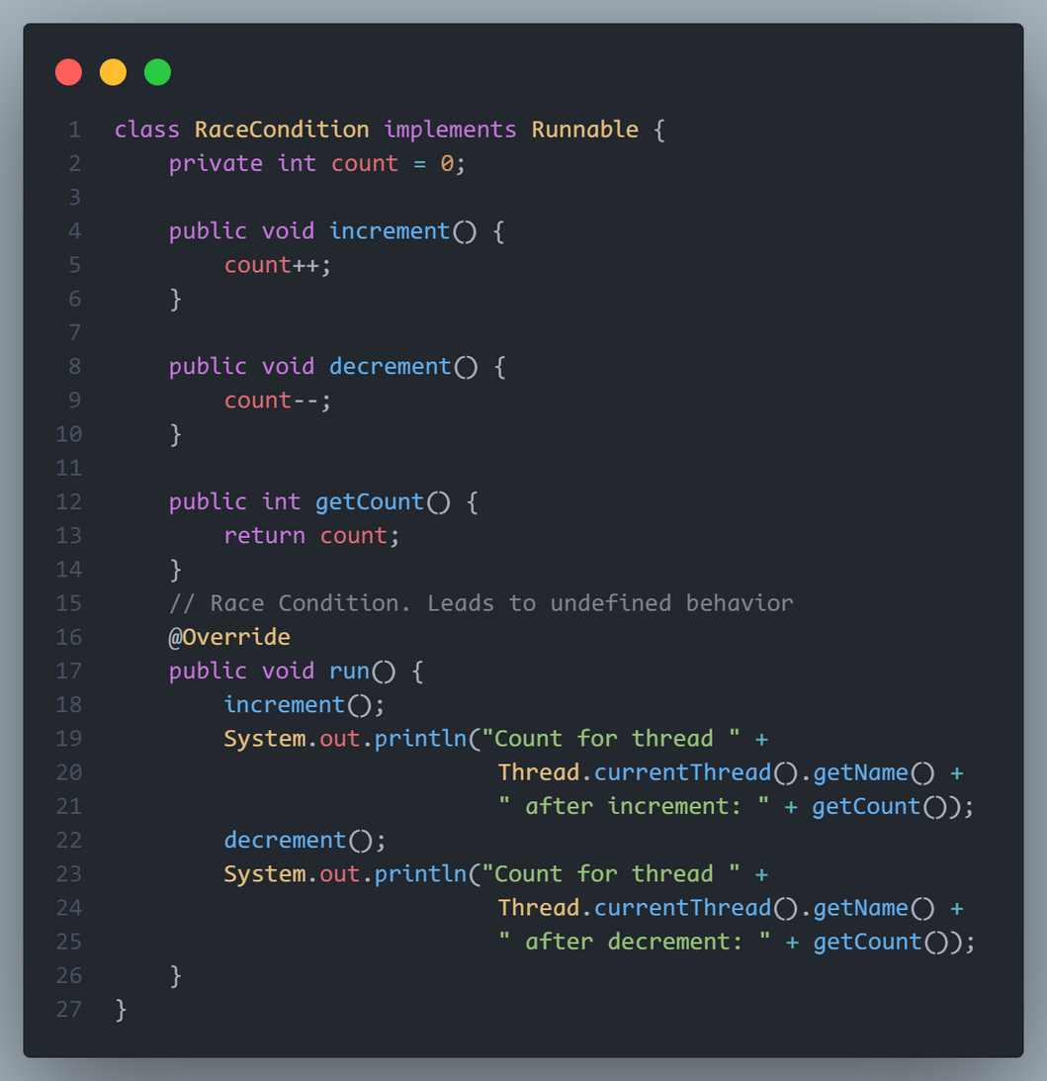
Race Condition Example

Slide 30
Thread Starvation
occurs when a thread is unable to gain access to shared resources or CPU time due to other threads monopolizing those resources. Example: A high-priority thread continuously acquires a lock on a shared resource, preventing lower-priority threads from accessing it
Starvation can also be caused by a problem with resource management where a process runs out of resources in the OS because those resources are being utilised by other processes.

Slide 31
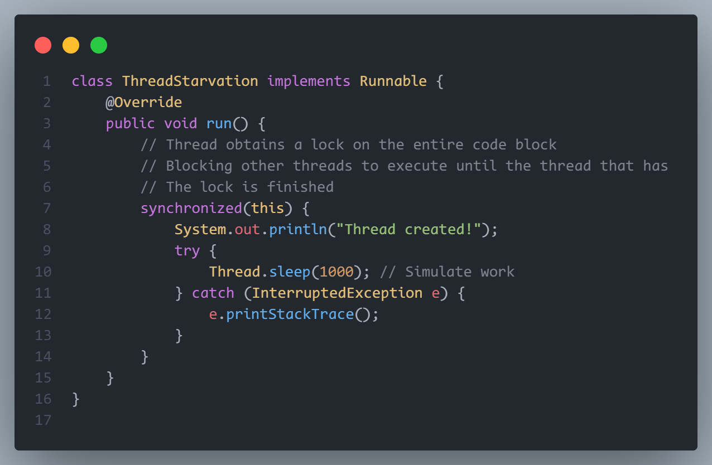
Thread Starvation Example

